Slide 1
6.4 A systematic approach to solving a system of linear equations

Slide 2
Introduction
In this topic, we will
Introduce the next section
Give an overview of what will be covered

Slide 3
Systematic approach
We have now seen that these two problems are equivalent:
Find a linear combination of n vectors in R^{m} that equals a target vector v, also in in R^{m}
Solve this system of m linear equations in n unknowns

Slide 4
Systematic techniques
Solving such algebraic equations by hand is difficult, at best, and tedious and error prone
We will introduce a technique that will solve such a system that eliminates the variable names
This technique can easily be programmed into a computer

Slide 5
Linear combinations to linear equations
In the next few topics, we will:
Define matrices, its entries, column vectors
Define the augmented matrix equivalent to a given system of linear equations
Define the possible row operations
Define leading zeros in a row, the leading non-zero entry in a row, and row-echelon form
Describing numerically stable algorithms that manipulate the augmented matrix to find a solution to the system of linear equations:
Gaussian elimination with partial pivoting
Backward substitution

Slide 6
Summary
Following this topic, you now
Understand the purpose of the next five topics
Know that at the end of this sequence of topics,
you will be able to either find a solution to a system of linear equations or determine no solution exists

Slide 7
References
[1] https://en.wikipedia.org/wiki/System_of_linear_equations

Slide 8
Acknowledgments
None so far.

Slide 9
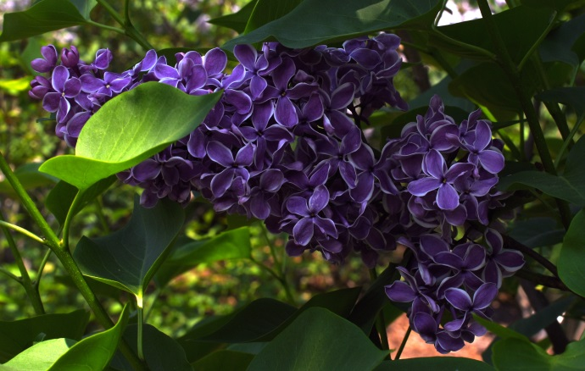
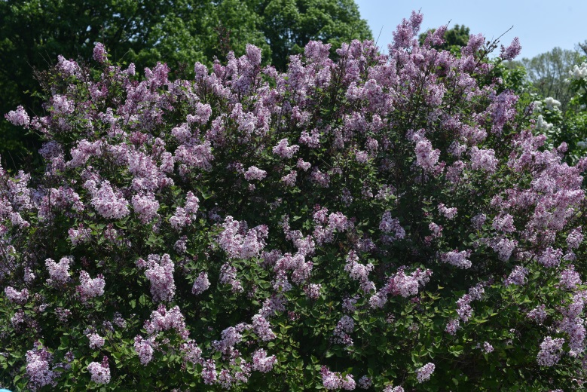
Colophon
These slides were prepared using the Cambria typeface. Mathematical equations use Times New Roman, and source code is presented using Consolas. Mathematical equations are prepared in MathType by Design Science, Inc.
Examples may be formulated and checked using Maple by Maplesoft, Inc.
The photographs of flowers and a monarch butter appearing on the title slide and accenting the top of each other slide were taken at the Royal Botanical Gardens in October of 2017 by Douglas Wilhelm Harder. Please see
https://www.rbg.ca/
for more information.

Slide 10
Disclaimer
These slides are provided for the ne 112 Linear algebra for nanotechnology engineering course taught at the University of Waterloo. The material in it reflects the authors’ best judgment in light of the information available to them at the time of preparation. Any reliance on these course slides by any party for any other purpose are the responsibility of such parties. The authors accept no responsibility for damages, if any, suffered by any party as a result of decisions made or actions based on these course slides for any other purpose than that for which it was intended.

